Slide 1
More CSS
<link href="filename" type="text/css" rel="stylesheet" />

Slide 2
HTML id attribute
<p>Coding Horror! Coding Horror!</p>
<p id="mission">Our mission is to combine programming and <q>human</q> factors with geekiness!</p>
HTML
Coding Horror! Coding Horror!
Our mission is to combine programming and “human” factors with geekiness! output
A unique ID for an element on a page
Each ID must be unique; can only be used once in the page
Notes:
<!DOCTYPE html PUBLIC "-//W3C//DTD XHTML 1.1//EN"
"http://www.w3.org/TR/xhtml11/DTD/xhtml11.dtd">
<html xmlns="http://www.w3.org/1999/xhtml">
<head>
information about the page
</head>
<body>
page contents
</body>
</html>

Slide 3
Linking to sections of a web page
<p>Visit <a href=
"http://www.textpad.com/download/index.html#downloads">
textpad.com</a> to get the TextPad editor.</p>
<p><a href="#mission">View our Mission Statement</a></p> HTML
Visit textpad.com to get the TextPad editor.
View our Mission Statement output
Link target can include an ID at the end, preceded by a #
Browser will load that page and scroll to element with given ID

Slide 4
CSS ID selectors
#mission {
font-style: italic;
font-family: "Garamond", "Century Gothic", serif;
} CSS
Coding Horror! Coding Horror!
Our mission is to combine programming and “human” factors with geekiness! output
Applies style only to the paragraph that has the ID of mission

Slide 5
HTML class attribute
<p class="shout">Coding Horror! Coding Horror!</p>
<p class="special">See our special deal on Droids!</p>
<p class="special">Today only!</p> HTML
Coding Horror! Coding Horror!
See our special deal on Droids!
Today only! output
A way to group some elements and give a style to only that group
Unlike an id, a class can be reused as much as you like
on the page
Notes:
(“I don't want ALL paragraphs to be yellow, just these three...”)

Slide 6
CSS class selectors
.special {
background-color: yellow;
font-weight: bold;
}
p.shout {
color: red;
font-family: cursive;
} CSS
Coding Horror! Coding Horror!
output
See our special deal on Droids!
Today only!
Notes:
(“I don't want ALL paragraphs to be yellow, just these three...”)

Slide 7
CSS class selectors
<p class="shout">Coding Horror! Coding Horror!</p>
<p class="special">See our special deal on Droids!</p>
<p class="special shout">Today only!</p> HTML
Coding Horror! Coding Horror!
output
See our special deal on Droids!
Today only!
Notes:
an element can be a member of multiple classes (separated by spaces)

Slide 8
CSS ID selectors: PSEUDO CLASSES
A pseudo-class is used to define a special state of an element.
For example, it can be used to:
→Style an element when a user mouses over it
→Style visited and unvisited links differently
→Style an element when it gets focus
a:link { color: #FF0000; } /* unvisited link */
a:visited { color: #00FF00; } /* visited link */
a:hover { color: #FF00FF; } /* mouse over link */ CSS
Buy Early Buy Often!
output

Slide 9
CSS ID selectors: PSEUDO ELEMENT
class | description
:active | an activated or selected element
:focus | an element that has the keyboard focus
:hover | an element that has the mouse over it
:link | a link that has not been visited
:visited | a link that has already been visited
:first-letter | the first letter of text inside an element
:first-line | the first line of text inside an element
:first-child | an element that is the first one to appear inside another

Slide 10
Styling Page Sections

Slide 11
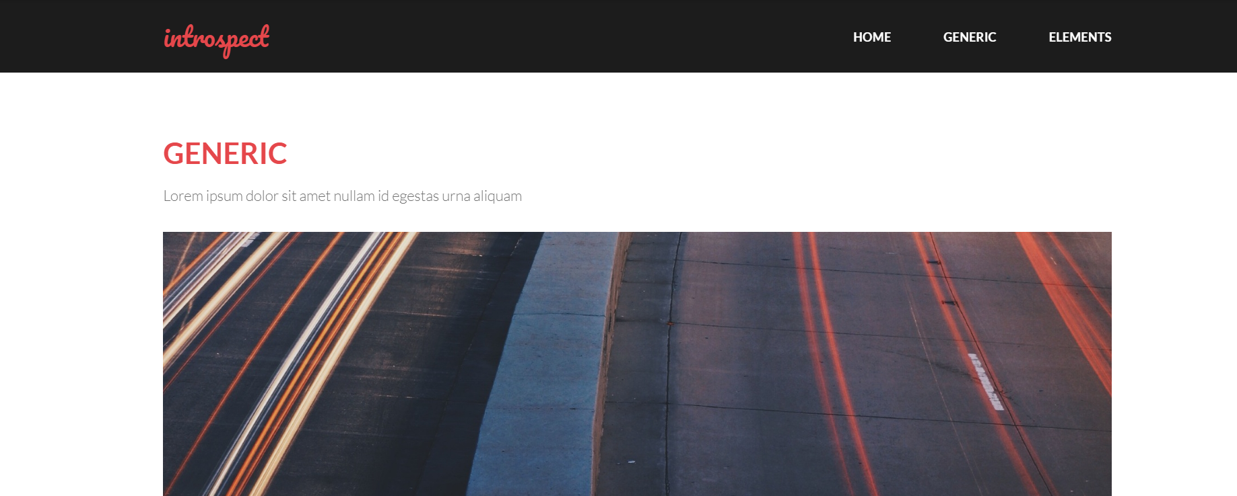
Why do we need page sections?
Style individual elements, groups of elements, sections of text or of the page
Create complex page layouts

Slide 12
Sections of a page <div>
<div class="shout">
<h2>Coding Horror! Coding Horror!</h2>
<p class="special">See our special deal on Droids!</p> <p>We'll beat any advertised price!</p>
</div> HTML
Coding Horror! Coding Horror!
We’ll beat any advertised price! output
See our special deal on Droids!
Tag used to indicate a logical section or area of a page
Has no appearance by default, but you can apply styles to it

Slide 13
Inline Sections <span>
<h2>Coding Horror! Coding Horror!</h2>
<p>See our <span class="special“>spectacular</span> deal on Droids!</p>
<p>We'll beat <span class="shout“> any advertised price</span>!</p>
HTML
Coding Horror! Coding Horror!
See our spectacular deal on Droids!
We’ll beat any advertised price! output
has no onscreen appearance, but you can apply a style or ID to it, which will be applied to the text inside the span

Slide 14
CSS context selectors – Combinator Selectors
selector1 selector2 {
properties
} CSS
applies the given properties to selector2 only if it is inside a selector1 on the page
selector1 > selector2 {
properties
} CSS
applies the given properties to selector2 only if it is directly inside a selector1 on the page
Notes:
(selector1 tag is immediately inside selector2 with no tags in between)

Slide 15
Context selector example
<p>Eat at <strong>Greasy's Burger</strong>...</p>
<ul>
<li>The <strong>greasiest</strong> burgers in town!</li>
<li>Yummy and greasy at the same time!</li>
</ul> HTML
li strong { text-decoration: underline; } CSS
Eat at Greasy’s Burger…
The greasiest burgers in town!
Yummy and greasy at the same time! output

Slide 16
More complex example
<div id="ad">
<p>Eat at <strong>Greasy's Burger</strong>...</p>
<ul>
<li class="important">The <strong>greasiest</strong> burgers in town!</li>
<li>Yummy and <strong>greasy at the same time </strong>!</li>
</ul>
</div> HTML
#ad li.important strong { text-decoration: underline; } CSS
Eat at Greasy’s Burger…
The greasiest burgers in town!
Yummy and greasy at the same time! output

Slide 17
Floating Elements

Slide 18

The CSS float property (reference)
img.headericon {
float: right; width: 130px;
} CSS
Ghostbusters is a 1984 American science fiction comedy
film written by co-stars Dan Aykroyd and Harold Ramis
about three eccentric New York City
parapsychologists-turned-ghost capturers.
output
property | description
float | side to hover on; can be left, right, or none (default)
removed from normal document flow; underlying text wraps around as necessary

Slide 19
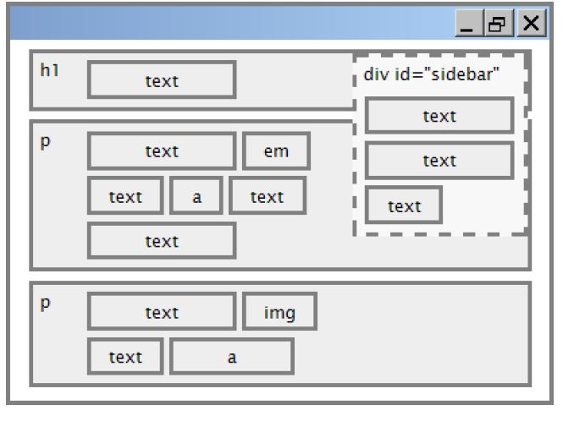
Floating elements diagram

Slide 20
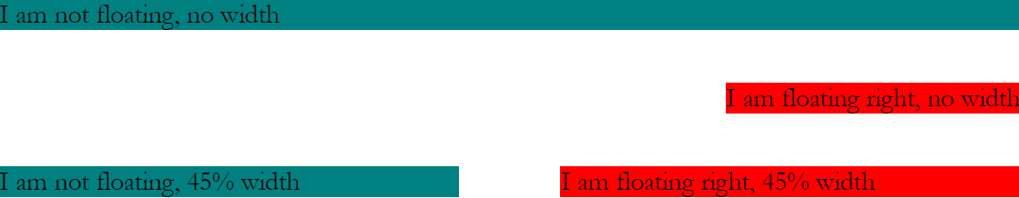
Common float bug: missing width
often floating block elements must have a width property value
Let’s try “floating”
Notes:
if no width is specified, the floating element may occupy 100% of the page width, so no content can wrap around it

Slide 21
The clear property (cont.)
property | description
clear | disallows floating elements from overlapping this element; can be left, right, or none (default)

Slide 22

The clear property
p { background-color: fuchsia; }
h2 { clear: right; background-color: yellow; } CSS
Mario is a fictional character in his video game series.
Serving as Nintendo's mascot and the main protagonist
of the series, Mario has appeared in over 200 video
games since his creation.
output
Mario is a fictional character in his video game series. Serving as Nintendo's mascot and the main protagonist of the series, Mario has appeared in over 200 video games since his creation
Super Mario Fan Site!

Slide 23
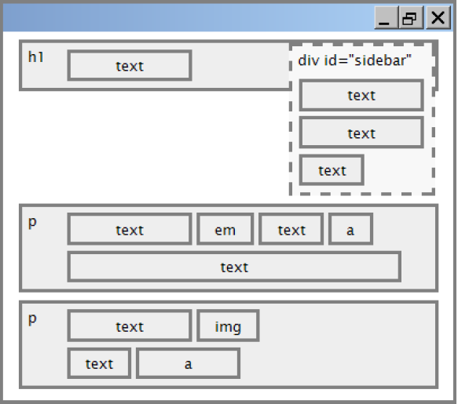
Clear diagram
div#sidebar { float: right; }
p { clear: right; } CSS

Slide 24
Common error: container too short
<p><img src="images/mario.png" alt=“super mario" />
Mario is a fictional character in his video game series.....</p> HTML
p { border: 2px dashed black; }
img { float: right; } CSS
Mario is a fictional character in his video game series.
Serving as Nintendo's mascot and the main protagonist
of the series, Mario has appeared in over 200 video
games since his creation.
output
Notes:
We want the p containing the image to extend downward so that its border encloses the entire image

Slide 25
The overflow property
p { border: 2px dashed black;
overflow: hidden; } CSS
Mario is a fictional character in his video game series.
Serving as Nintendo's mascot and the main protagonist
of the series, Mario has appeared in over 200 video
games since his creation.
output
Notes:
We want the p containing the image to extend downward so that its border encloses the entire image

Slide 26
The overflow property (cont.)
property | description
overflow | specifies what to do if an element's content is too large; can be auto, visible, hidden, or scroll
Notes:
We want the p containing the image to extend downward so that its border encloses the entire image

Slide 27
Multi-column layouts
<div>
<p>first paragraph</p>
<p>second paragraph</p>
<p>third paragraph</p>
Some other text that is important
</div> HTML
p { float: right; width: 25%; margin: 0.5em;
border: 2px solid black; }
div { border: 3px dotted green; overflow: hidden; } CSS
Some other text that is important
output
third paragraph
second paragraph
first paragraph
Notes:
We want the p containing the image to extend downward so that its border encloses the entire image

Slide 28
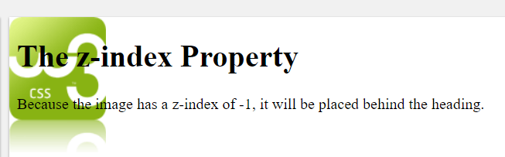
Z-index
The z-index property specifies the stack order of an element.
<h1>The z-index Property</h1>
<img src="w3css.gif" width="100" height="140">
<p>Because the image has a z-index of -1, it will be placed behind the heading.</p>
HTML
img { position: absolute;
left: 0px; top: 0px; z-index: -1;
} CSS
Notes:
We want the p containing the image to extend downward so that its border encloses the entire image

Slide 29
Media Query

Slide 30
What is the viewport
The viewport is the user's visible area of a web page.
The viewport varies with the device, and will be smaller on a mobile phone than on a computer screen.
HTML5 introduced a method to let web designers take control over the viewport, through the <meta> tag.
<meta name="viewport" content="width=device-width, initial-scale=1.0">
A <meta> viewport element gives the browser instructions on how to control the page's dimensions and scaling.
The width=device-width part sets the width of the page to follow the screen-width of the device (which will vary depending on the device).
The initial-scale=1.0 part sets the initial zoom level when the page is first loaded by the browser.
Notes:
We want the p containing the image to extend downward so that its border encloses the entire image

Slide 31
Media query
It uses the @media rule to include a block of CSS properties only if a certain condition is true.
<head>
<title>Media Queries Example</title>
<meta name="viewport" content="width=device-width,initial-scale=1.0">
<link rel="stylesheet" type="text/css" href="style.css">
</head>
<body>
<div class="container">
<header id="header"></header>
<div class="box box1">Box 1</div>
<div class="box box2">Box 2</div>
<div class="box box3">Box 3</div>
<div class="box box4">Box 4</div>
<div class="clearfix"></div>
</div>
</body>
HTML
Notes:
We want the p containing the image to extend downward so that its border encloses the entire image

Slide 32
Media query
It uses the @media rule to include a block of CSS properties only if a certain condition is true.
* {
margin: 0px;
}
body, html{
width: 100%;
height: 100%;
}
.container{
width: 100%;
max-width: 1100px;
margin-left: auto;
margin-right: auto;
background-color: #ccc;
}
CSS
#header {
height: 120px;
background-color: blue;
}
.box{
width: 50%;
height: 140px;
float: left;
}
CSS
.box1{
background-color: yellow;
}
.box2{
background-color: green;
}
.box3{
background-color: red;
}
.box4{
background-color: orange;
}
.clearfix{
clear: both;
}
CSS
Notes:
We want the p containing the image to extend downward so that its border encloses the entire image

Slide 33
Media query
It uses the @media rule to include a block of CSS properties only if a certain condition is true.
/*screen for display screen or all for all type of devices*/
/*This is for tablet*/
@media screen and (max-width:768px){
.box1 {
width: 100%;
}
.box2 {
width: 100%;
}
}
/* Mobile */
@media screen and (max-width:320px){
.box3{
width: 100%;
}
.box4{
width: 100%;
}
}
CSS
Notes:
We want the p containing the image to extend downward so that its border encloses the entire image

